Slide 1
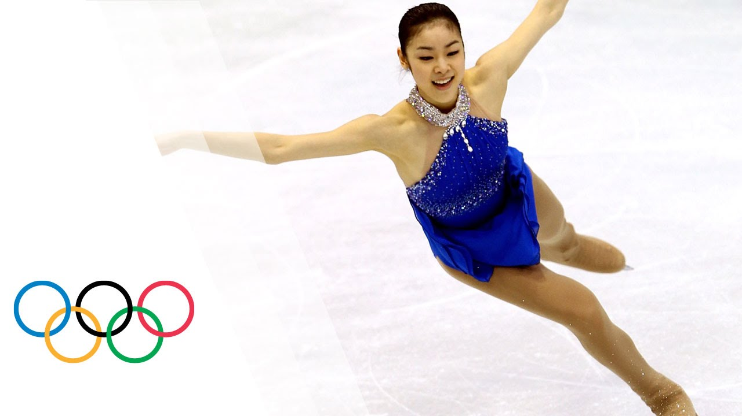
DATA301 - Final Project
Abigail Ibarrola
Analysis of Singles Figure Skating Scores and Trends

Slide 2
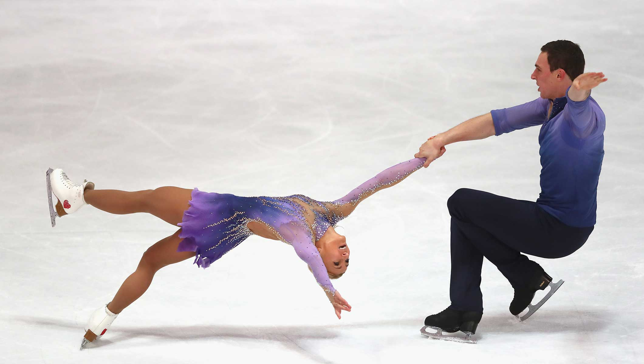
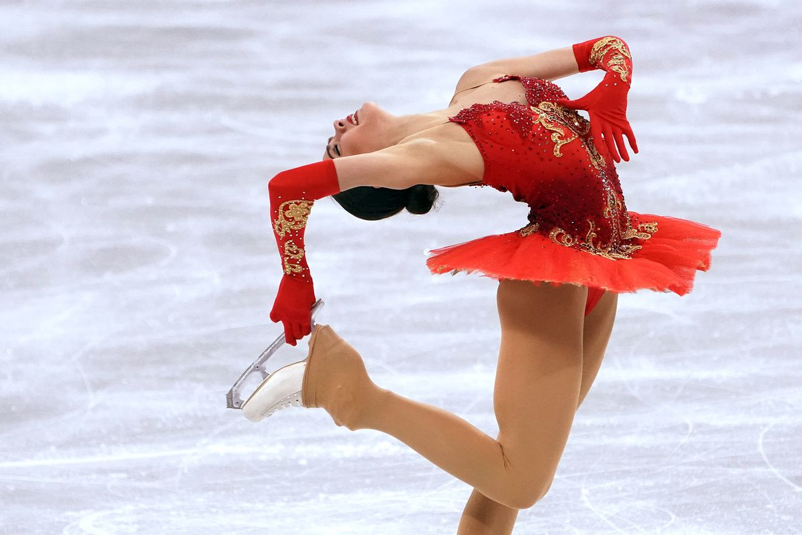
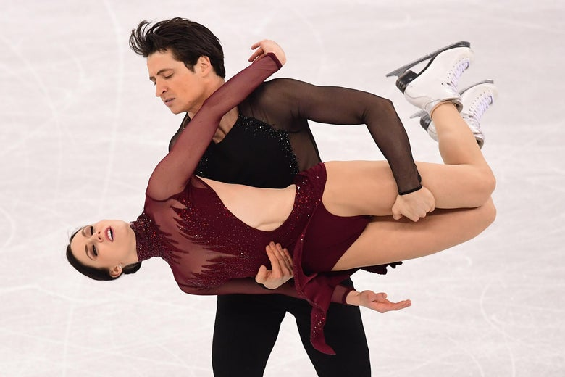
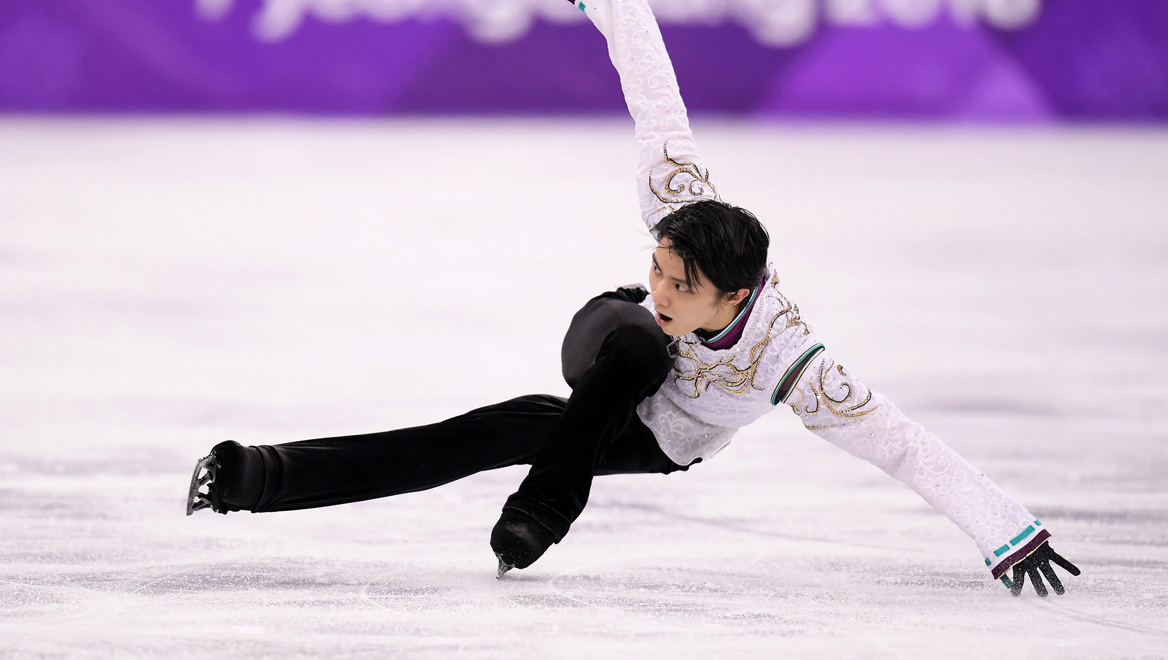
Introduction
Competitive Figure Skating has four disciplines: Men, Ladies, Pairs, Ice Dance
Two divisions of top level competitive figure skating: Juniors and Seniors
In each competition, skaters perform a short program and a long program
Final score is a combination of short and long program scores
Nine judges of different nationalities score each program
Focused on senior-level singles disciplines

Slide 3
Terminology
Base Value (BV)
Each technical element (jumps, spins, etc.) has an assigned base value, depending on difficulty.
Technical Element Score (TES)
TES is (roughly) the sum of the BV and GOE for all technical elements.
Depending on how a skater executes an element, judges assign GOE point values to be added to the BV of the element. From 2004, the GOE ranged from -3 to +3, from 2018, it ranges from -5 to +5.
Program Component Score (PCS)
A separate set of element scores based on skaters’ Skating Skills, Transitions, Performance, Composition, Interpretation. There is no base value; judges give a score (roughly) ranging from 1 to 10 for each component.

Slide 4
1
DATA COLLECTION

Slide 5
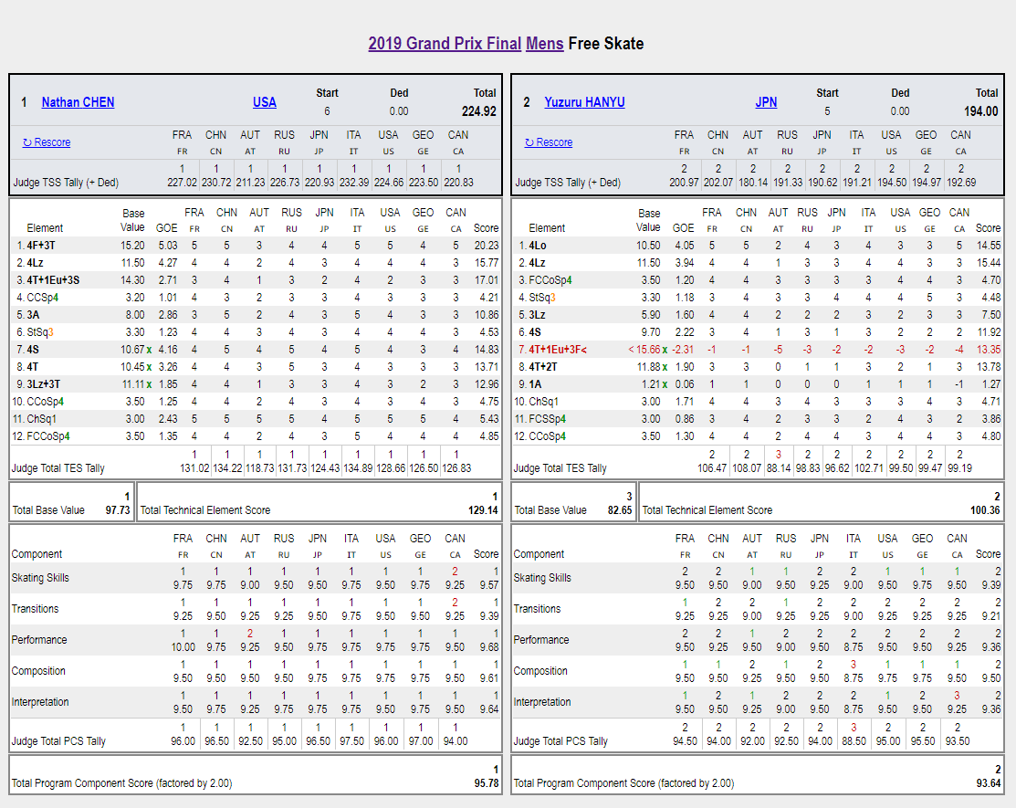
Retrieved all data through web scraping skatingscores.com
Site had pre-calculated judge TES, PCS, and total scores
Parsed all Ladies / Men short and long programs, for every major competition since 2010-11 season until now

Slide 6
2
DATA CLEANING

Slide 7
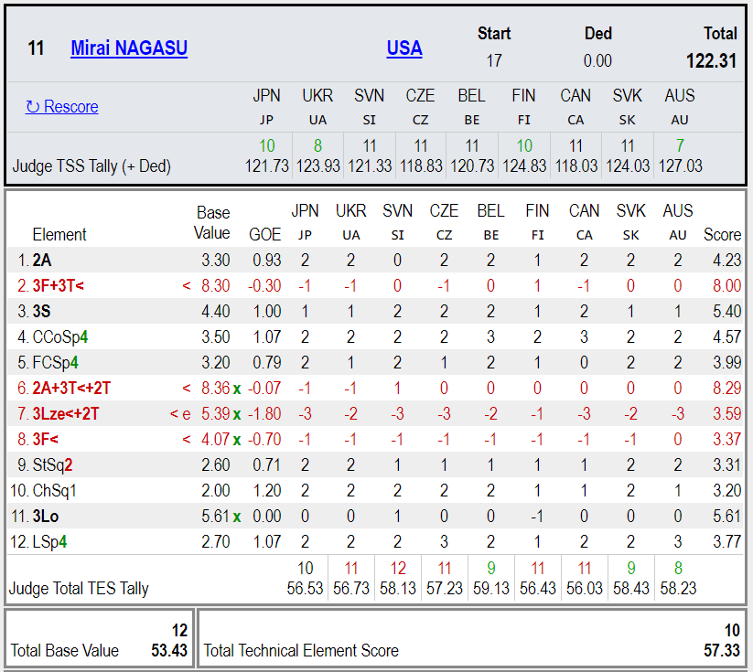
Cleaning
Errors on technical elements are indicated on the name of the element itself
Extract out characters indicating errors, use that to count number of errors
EX. 3F and 3F< are the same jump, but 3F< is underrotated
Had to clean out some missing judge scores

Slide 8
Organization
Created DataFrame for each individual skater performance
Includes skater’s nationality, name
Includes final total, TES, and PCS scores, as well as each individual judge’s total, TES, and PCS scores
Created DataFrames for each individual jump, spin, PCS from every skater performance
Created DataFrame associating judge name with their nationality
Aggregated jump / spin data by measuring counts of each type of jump and number of errors
Merged aggregated jump / spin data, and judge nationalities to overall skater DataFrame

Slide 9
3
DATA EXPLORATION

Slide 10
About Exploration
To analyze judges’ scoring trends, used difference of judge’s score from skater’s final score
Makes it relative to each performance
Focused on top skating nations for this presentation: Japan, Russia, USA, China, Canada, Korea

Slide 11
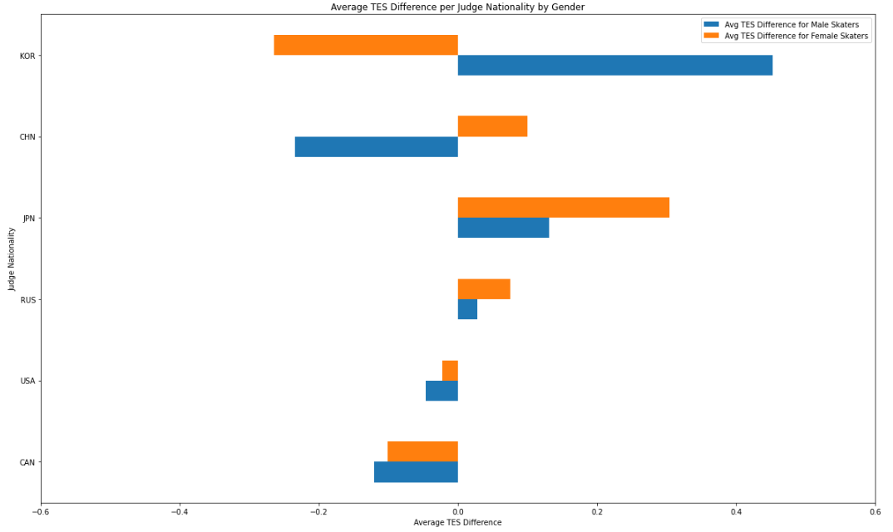
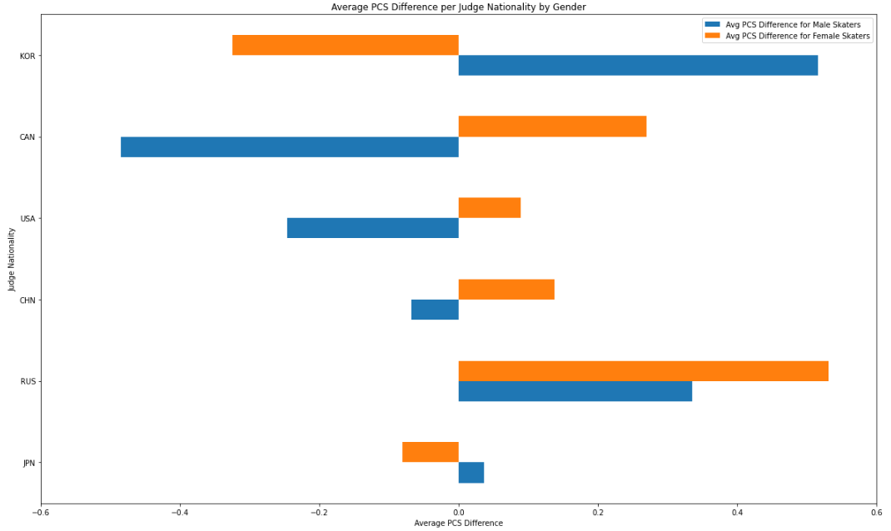
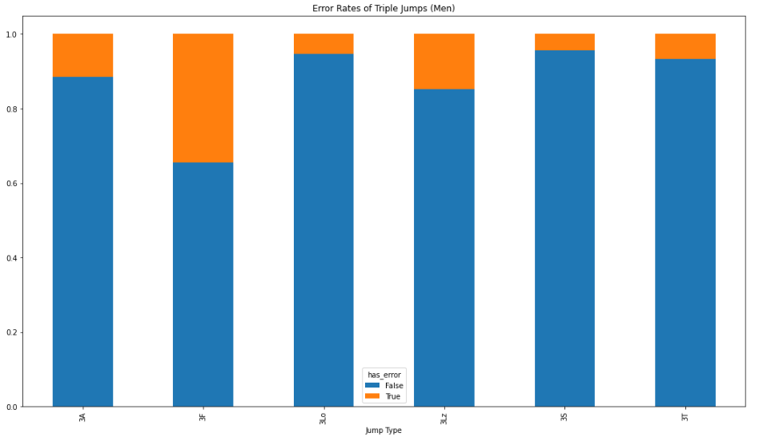
Average TES / PCS Difference: Skater Gender
TES
PCS

Slide 12
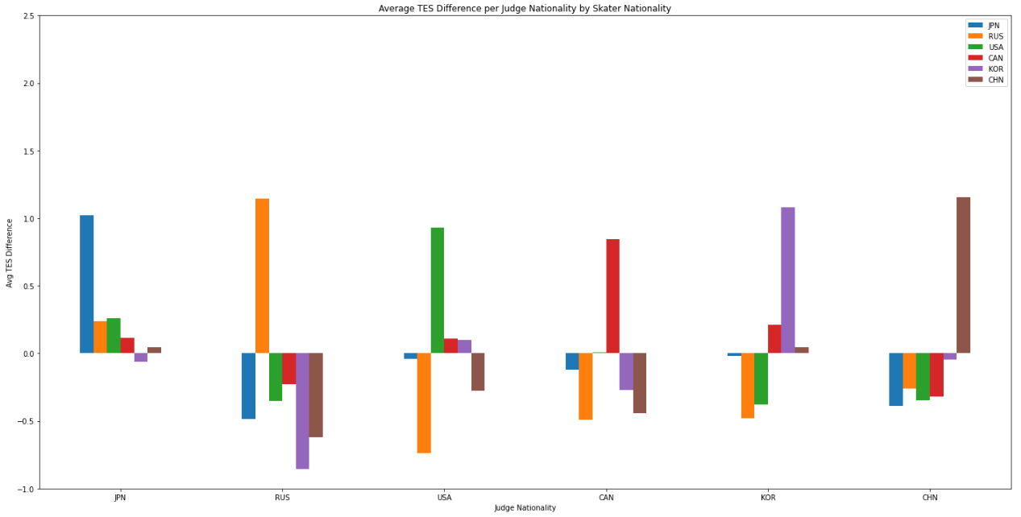
Average TES Difference: Skater Nationality

Slide 13
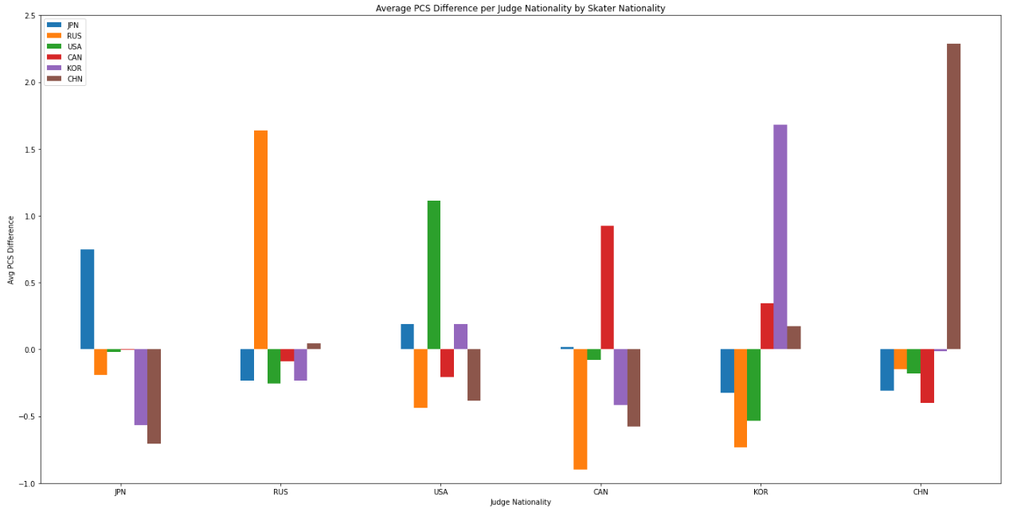
Average PCS Difference: Skater Nationality

Slide 14
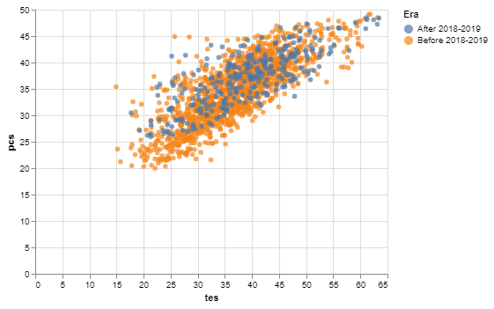
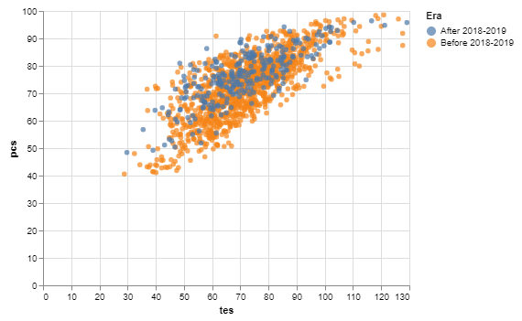
TES vs PCS: Men
Men Short Program
Strong direct relationship
New GOE era has not shown any major increase in TES scores
Slight increase in GOE in lower end of TES spectrum
Men Long Program

Slide 15
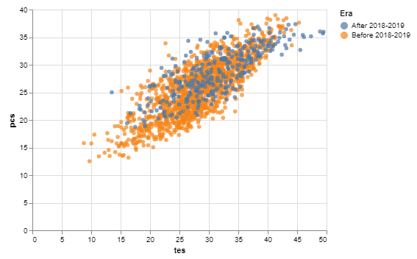
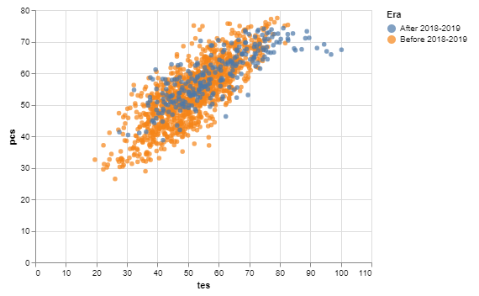
TES vs PCS: Ladies
Ladies Short Program
Direct relationship
New GOE era shows more variance, shows emergence of higher technical programs
These high TES programs don’t always get the highest PCS scores
Ladies Long Program

Slide 16
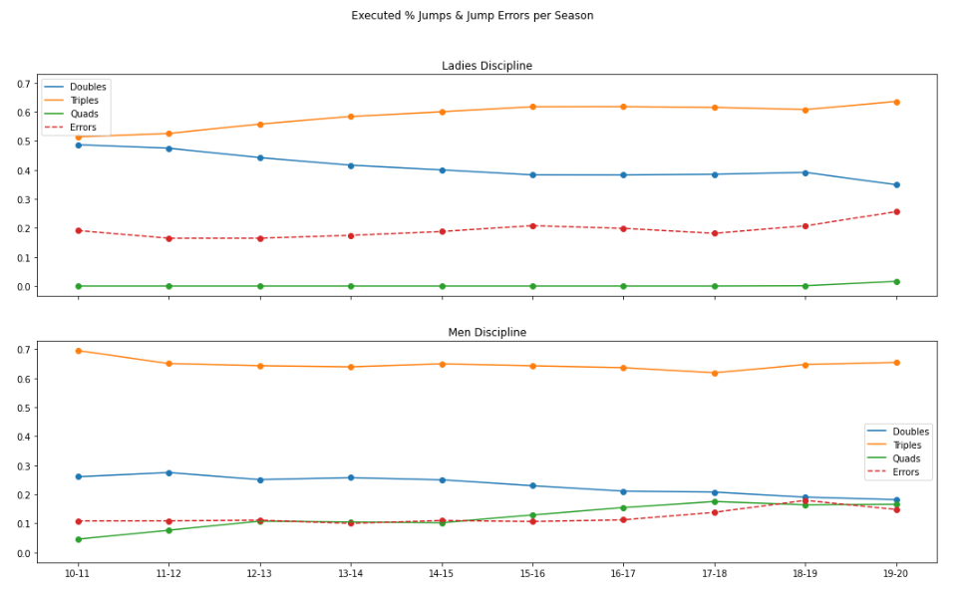
Percentage of Types of Jumps Executed & Errors

Slide 17
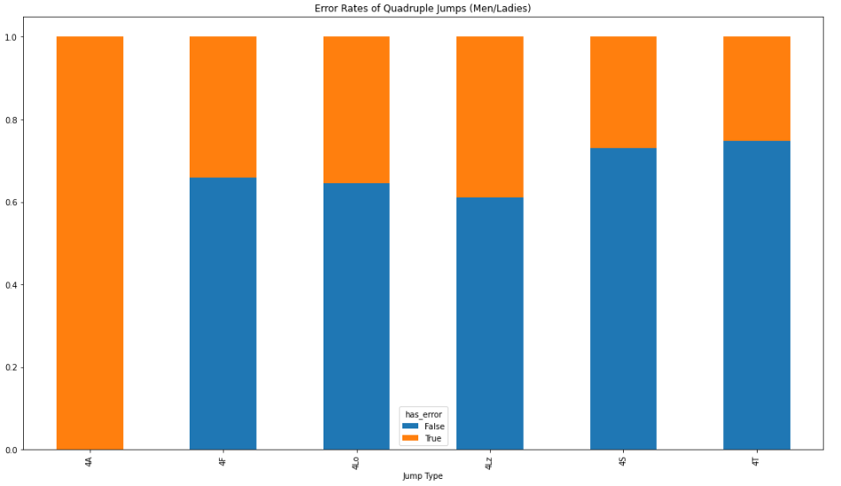
Which quadruple jumps are more reliable?
(Does not include falls, step outs, etc)
(Across both Men & Ladies)
4A
4F
4Lo
4Lz
4S
4T

Slide 18
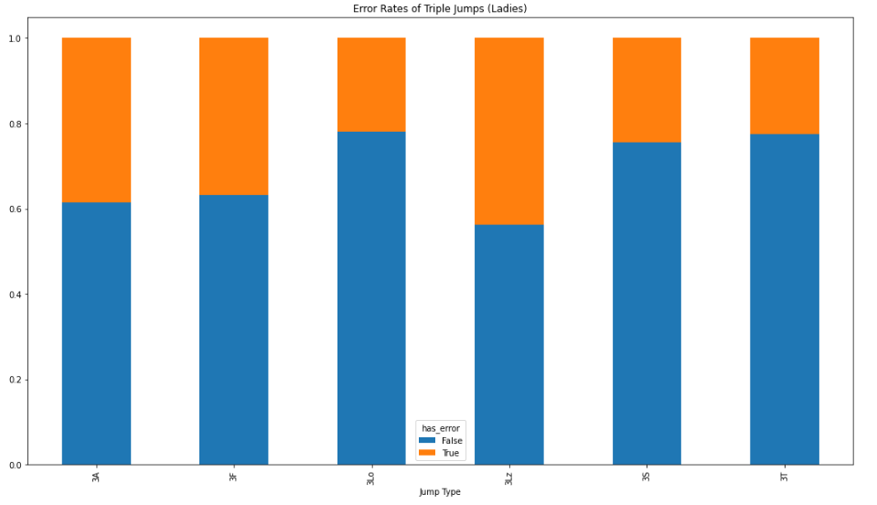
Which triple jumps are more reliable?
(Does not include falls, step outs, etc)
Men
Ladies
3A
3F
3Lo
3Lz
3S
3T
3A
3F
3Lo
3Lz
3S
3T

Slide 19
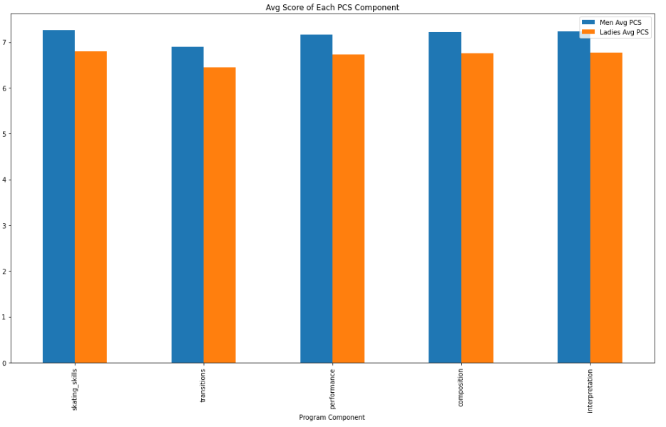
Most Successful Program Components
(Across both Men & Ladies)
SS
TR
PE
CO
IN

Slide 20
4
MACHINE LEARNING

Slide 21
Machine Learning Set Up
Other Features:
Number of Quad, Triple, Double Jumps
Number of Jump Errors
Number of Spin Errors
Goal: How well can I predict a skater’s score (per individual judge)?
Primary Features:
Skater’s Name
Skater’s Nationality
Judge’s Nationality
BV
Gender
Predicting quantitative value: use regression
Reorganized data so that a single row contains one judge’s score
Only used data with known judges (starting from 2016-2017 season)
Selected 10 male and female skaters and segmented out their most recent competition to use as test data

Slide 22
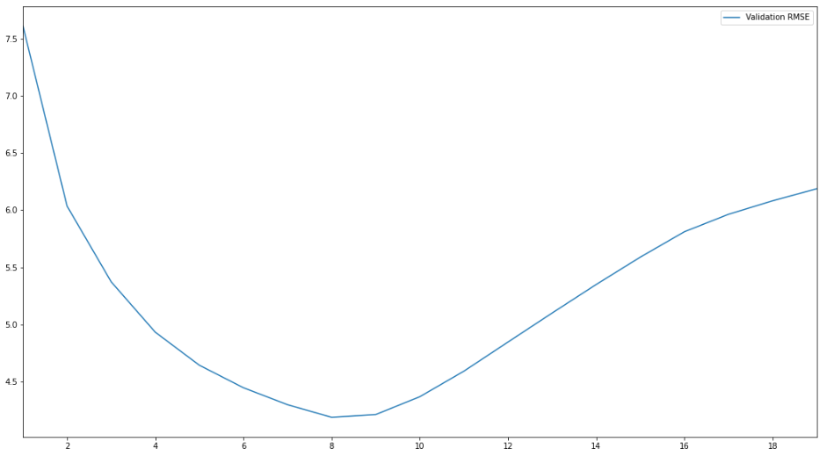
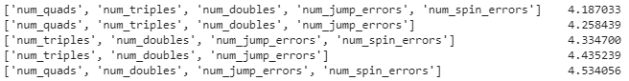
K-Nearest Neighbors Regression
K = 8 was best
Of all combinations of other features and primary features, using all features worked best
Best Validation RMSE: 4.187033
k vs. Validation RMSE
Feature Exploration

Slide 23
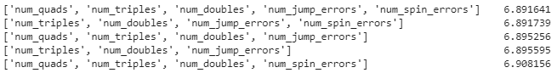
Linear Regression
Standardizing quantitative features worked best
Of all combinations of other features and primary features, using all features worked best
Best Validation RMSE: 6.891641
Feature Exploration

Slide 24
Ensemble Models
Ensembled Linear and KNeighbors models
Voting: Validation RMSE of 4.872629
Stacking: Validation RMSE of 4.172718

Slide 25
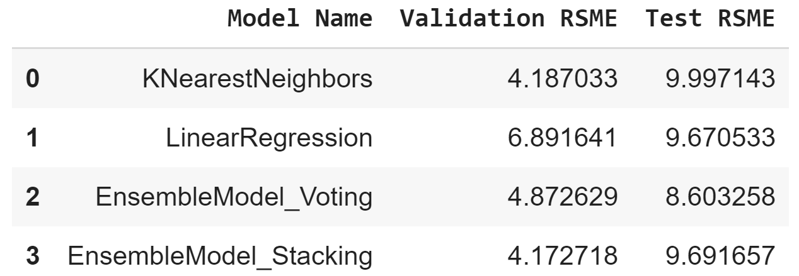
Making Predictions
The Stacking Ensemble Model had the best Validation RMSE
The Voting Ensemble Model ended up with the best Test RMSE

Slide 26
5
QUESTIONS?

